Slide 1
Data Visualization
Nguyen Minh Hoang
06/06/2022

Slide 2
Outline
1. Venn Diagram
2. Upsetplot
3. Heatmap
4. Parallel plot
5. Forest plot
6. Scatter Plot Matrices

Slide 3
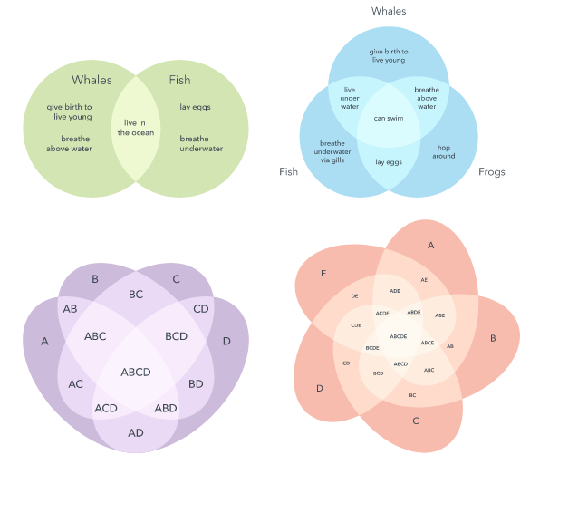
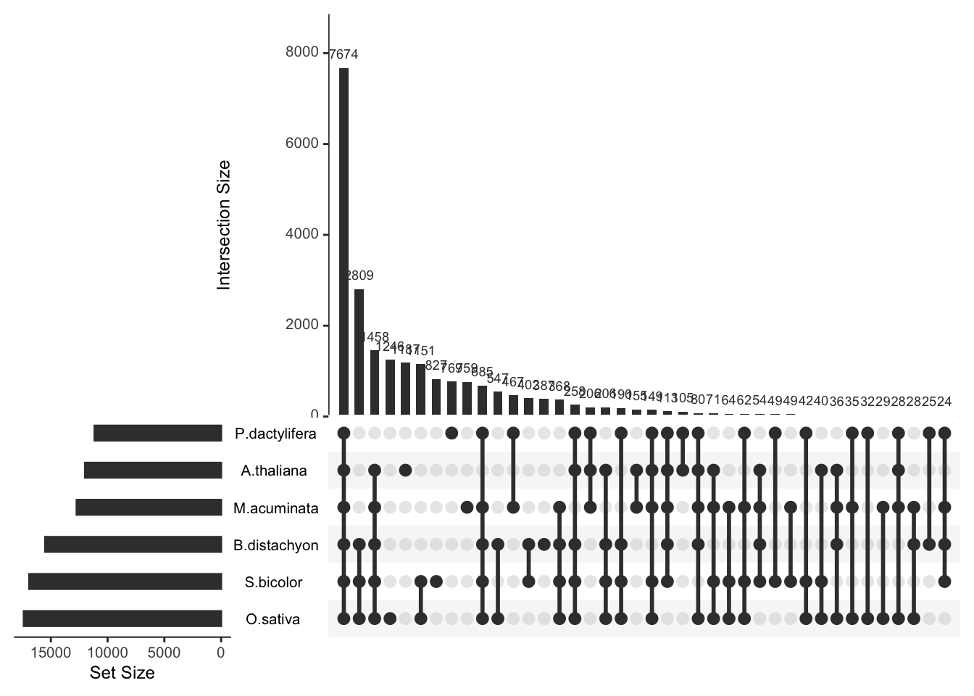
Venn diagram vs Upset plot

Slide 4
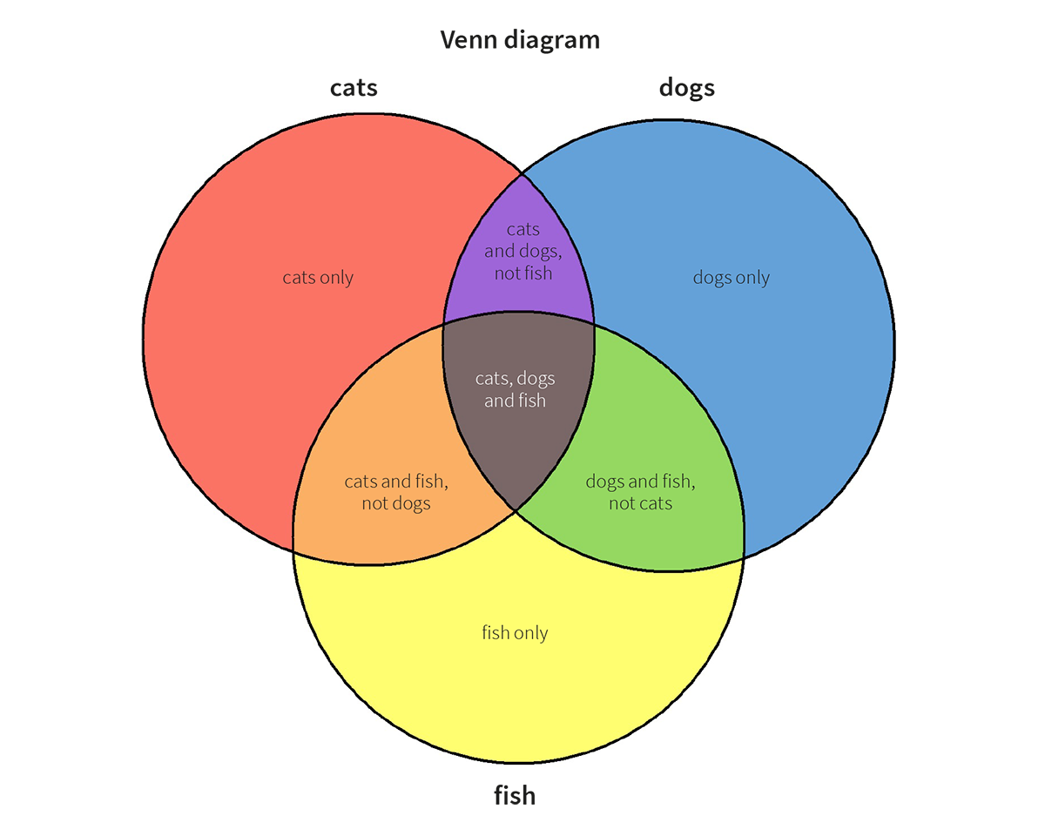
What is a Venn Diagram ?
A Venn diagram uses overlapping circles or other shapes to illustrate the logical relationships between two or more sets of items. Often, they serve to graphically organize things, highlighting how the items are similar and different.
https://r-graph-gallery.com/14-venn-diagramm.html

Slide 5
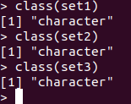
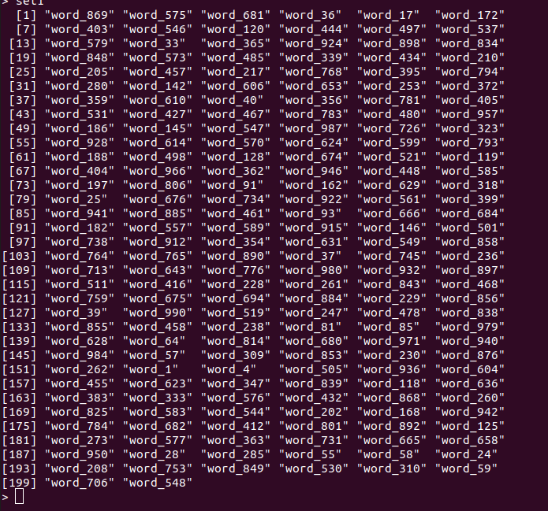
How to creat Venn Diagram?
install.packages('VennDiagram')
library(VennDiagram)
input datat
list
# Generate 3 sets of 200 words
> set1 <- paste(rep("word_" , 200) , sample(c(1:1000) , 200 , replace=F) , sep="")
> set2 <- paste(rep("word_" , 200) , sample(c(1:1000) , 200 , replace=F) , sep="")
> set3 <- paste(rep("word_" , 200) , sample(c(1:1000) , 200 , replace=F) , sep="")

Slide 6
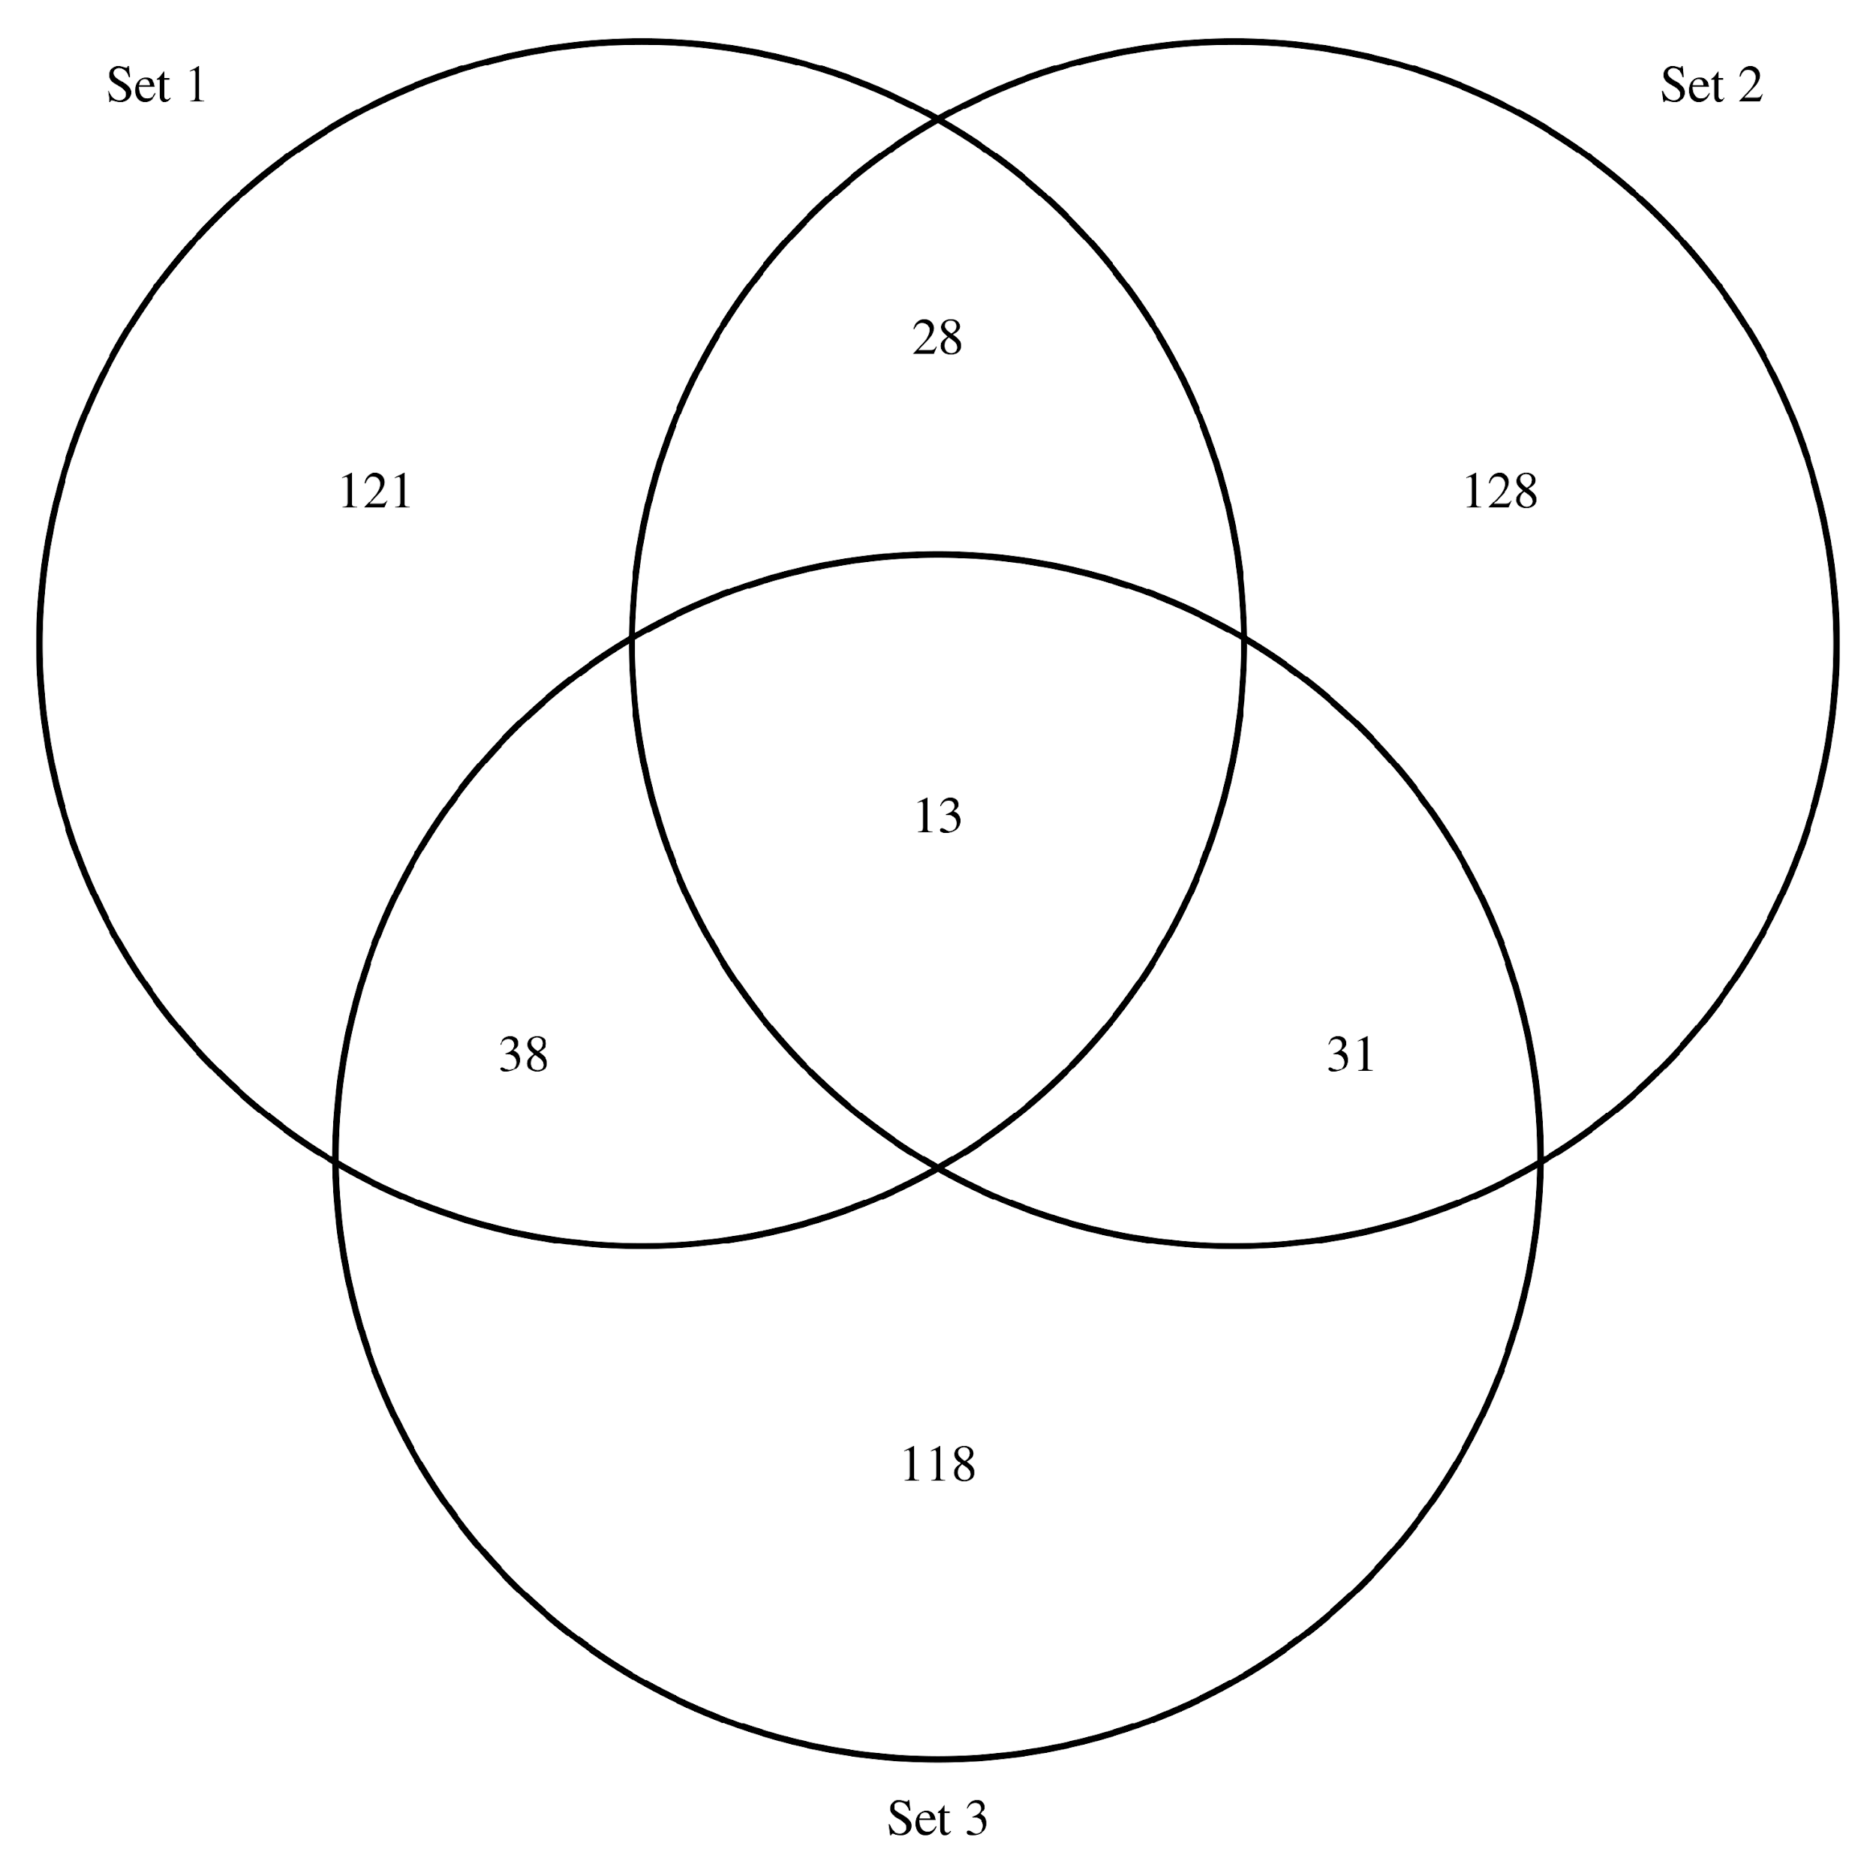
venn.diagram(
x = list(set1, set2, set3),
category.names = c("Set 1" , "Set 2 " , "Set 3"),
filename = '#14_venn_diagramm.png',
output=TRUE
)
The output is available as a .png file in your current working directory.

Slide 7
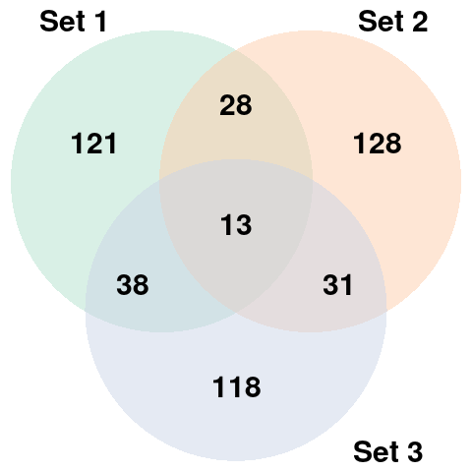
How to customize it Venn Diagram?
venn.diagram(
x = list(set1, set2, set3),
category.names = c("Set 1" , "Set 2 " , "Set 3"),
filename = '#14_venn_diagramm.png',
output=TRUE,
# Output features
imagetype="png" ,
height = 480 ,
width = 480 ,
resolution = 300,
compression = "lzw",
# Circles
lwd = 2,
lty = 'blank',
fill = myCol,
# Numbers
cex = .6,
fontface = "bold",
fontfamily = "sans",
# Set names
cat.cex = 0.6,
cat.fontface = "bold",
cat.default.pos = "outer",
cat.pos = c(-27, 27, 135),
cat.dist = c(0.055, 0.055, 0.085),
cat.fontfamily = "sans",
rotation = 1
)
# Prepare a palette of 3 colors with R colorbrewer:
library(RColorBrewer)
myCol <- brewer.pal(3, "Pastel2")
https://r-graph-gallery.com/14-venn-diagramm.html
Notes:
The venn.diagram() function offers several option to customize the output. Those options allow to customize the circles, the set names, and the intersection values.

Slide 8
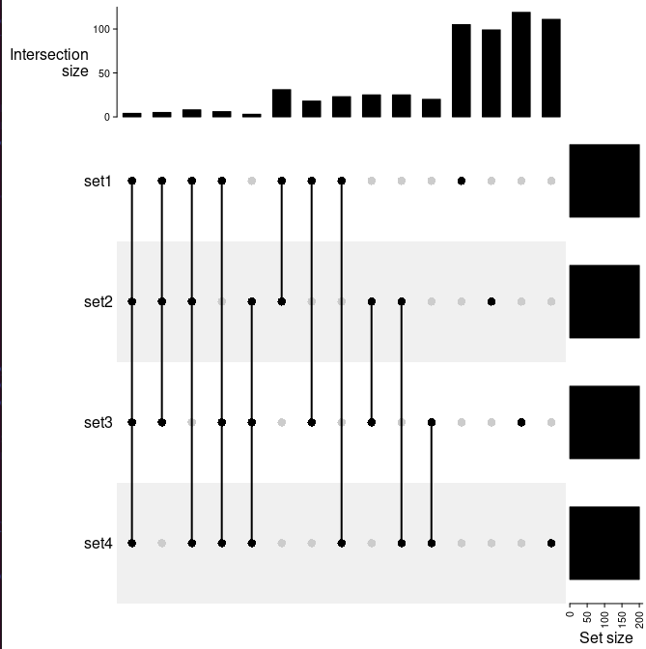
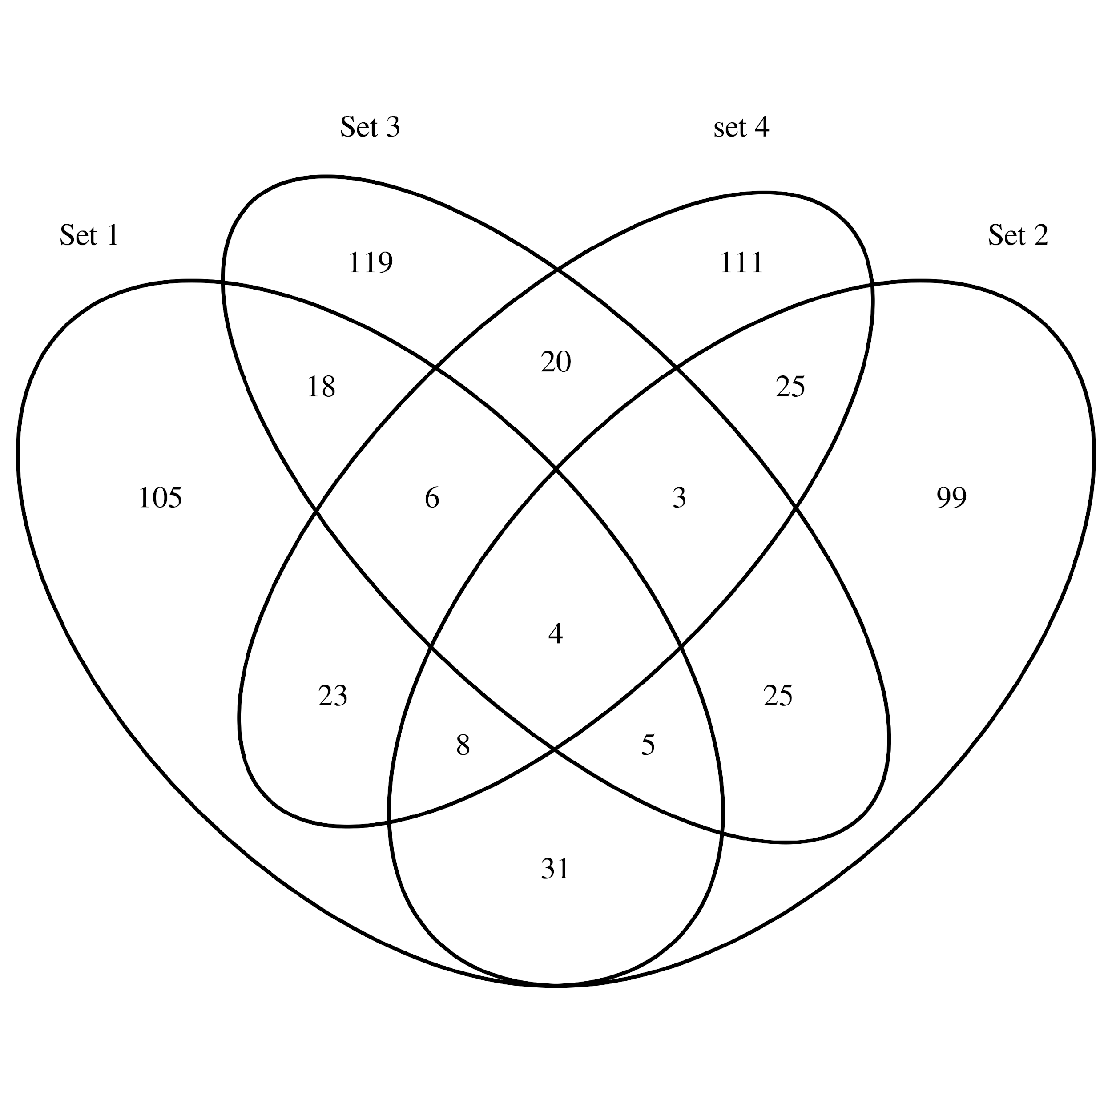
Upset plot
Understanding relationships between sets is an important analysis task. The major challenge in this context is the combinatorial explosion of the number of set intersections if the number of sets exceeds a trivial threshold. The most common set visualization approach – Venn Diagrams – doesn’t scale beyond three or four sets. UpSet, in contrast, is well suited for the quantitative analysis of data with more than three sets.
When should you use UpSet?
If we have 4 sets
UpSet works best for set data with more than three and less than about 30 sets.
UpSet is well suited for analyzing distributions and properties of many items.
UpSet shines when you want to look at all combinations of how sets intersect.

Slide 9
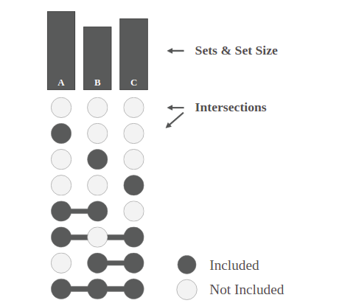
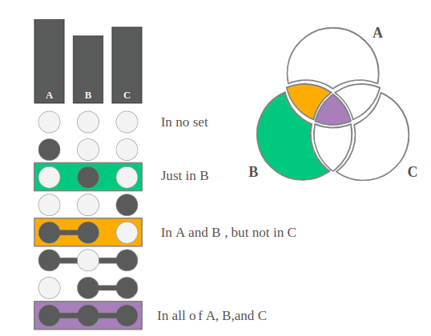
UpSet Explained
Notes:
Giải thích về thành phần của upset plot

Slide 10
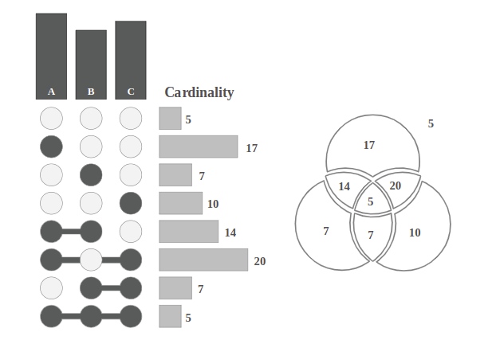
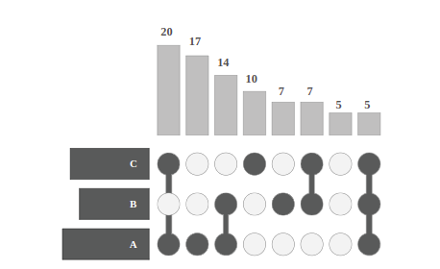
UpSet Explained
Notes:
Giải thích về cardinality

Slide 11
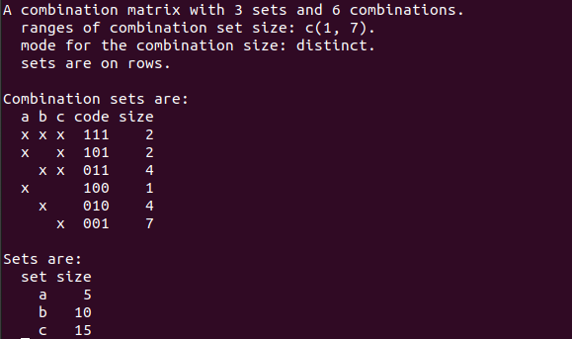
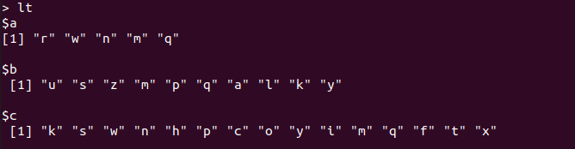
How to creat Upset plot ?
install.packages('UpSetR')
library(UpSetR)
Input data
lt = list(a = sample(letters, 5),
+ b = sample(letters, 10),
+ c = sample(letters, 15))
The function make_comb_mat() generates the combination matrix as well as calculates the size of the sets and the combination sets.
m = make_comb_mat(lt)
extract_comb(m, "111")
[1] "m" "q"
Notes:
m1 = make_comb_mat(lt) # the default mode is `distinct`
code 111 có nghĩa là cả ba set đều có và có hai phần tử
hàng cuối cùng 001 và size bằng bảy có nghĩa là 7 là cái của set c mà set a và b không nó là cái đặc trưng nhất
data (m): matrix

Slide 12
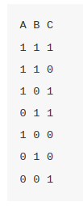
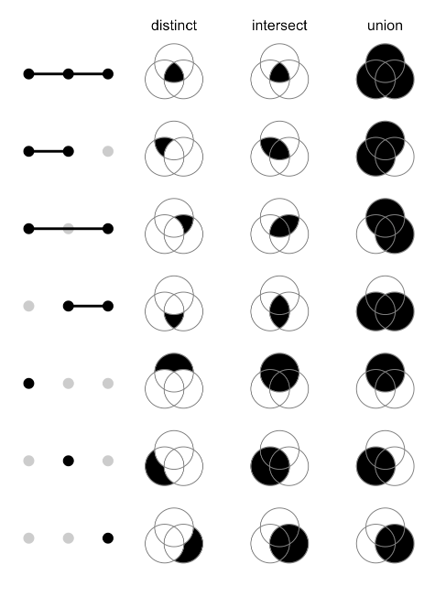
Combination matrix
A value of 1 means to select that set and 0 means not to select that set. E.g., 1 1 0 means to select set A, B while not set C. Note there is no 0 0 0, because the background set is not of interest here. In following part of this section, we refer A, B and C as sets and each combination as combination set. The whole binary matrix is called combination matrix.

Slide 13
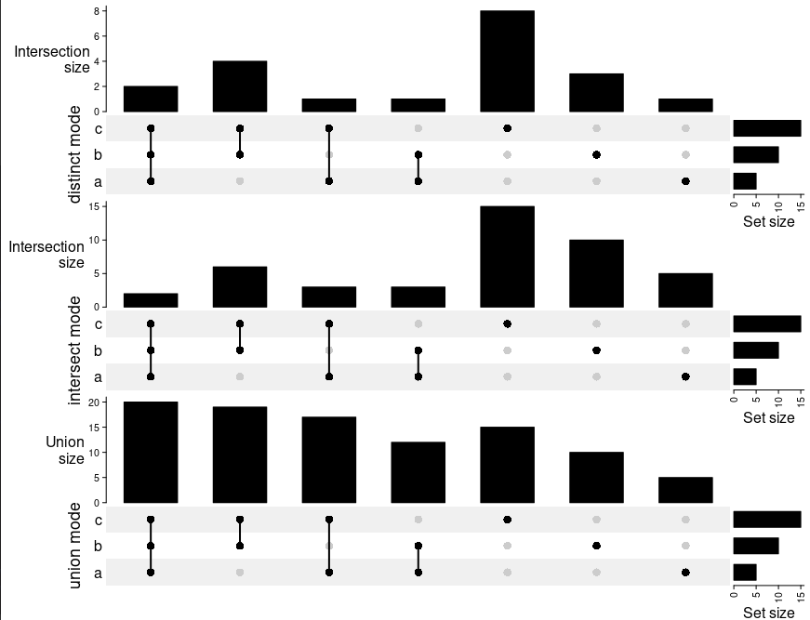
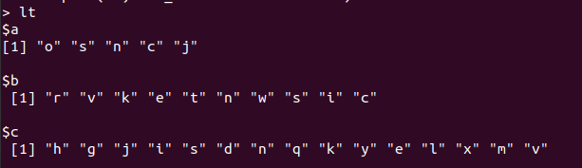
Combination matrix

Slide 14
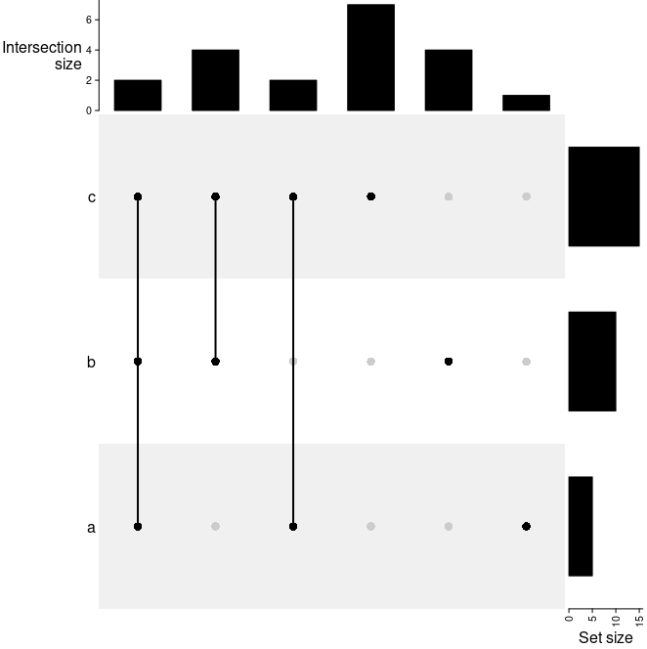
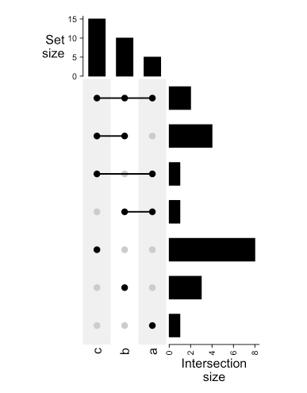
UpSet(m)
UpSet(t(m))

Slide 15
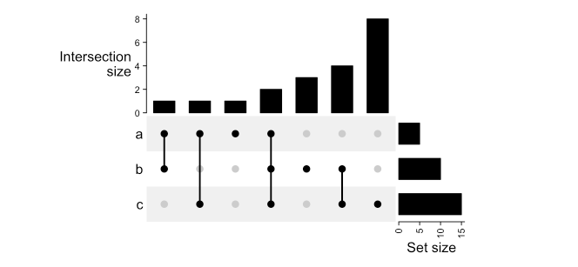
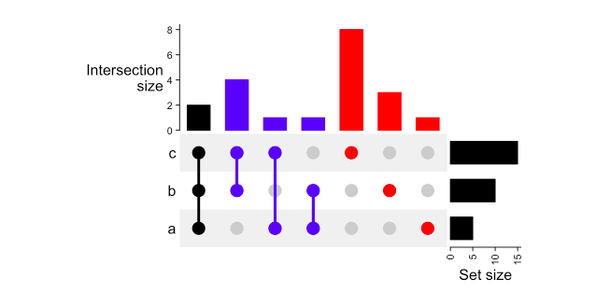
UpSet(m, set_order = c("a", "b", "c"), comb_order = order(comb_size(m)))
UpSet(m, pt_size = unit(5, "mm"), lwd = 3, comb_col = c("red", "blue", "black")[comb_degree(m)])

Slide 16
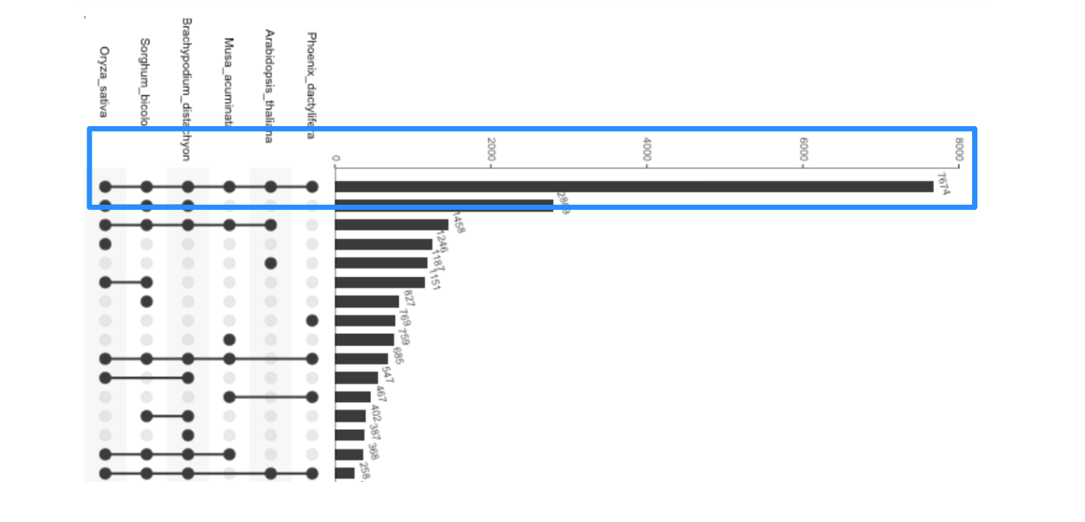
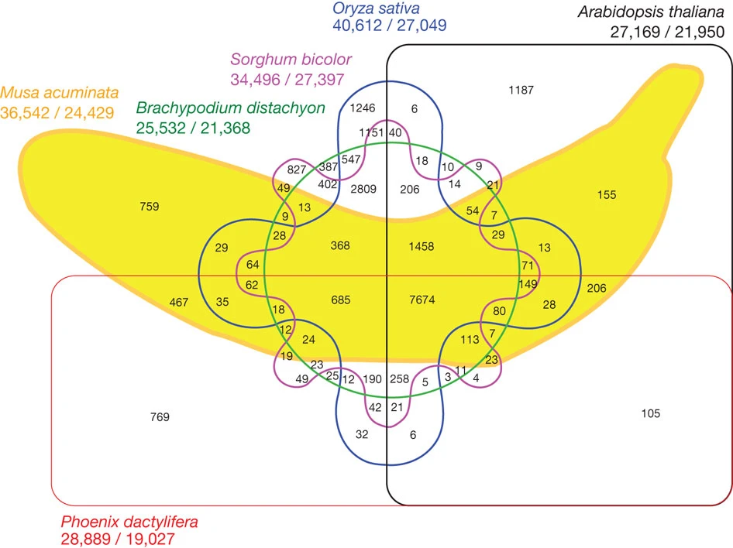
UpSet vs. Venn Diagrams
https://upset.app/
Notes:
Venn diagrams are not suitable to visualize intersections of more than three or four sets. The figure below shows an example of a six-set venn diagram published in Nature that shows the relationship between the banana’s genome and the genome of five other species by visualizing which genes are shared between the plant species/
While this figure looks fun, it is not a useful visualization. Try to extract any information from it. It’s really hard to trace which intersection involves which sets. It’s not obvious which is the biggest intersection from the visualization – you have to read the labels one by one.
You might ask, how does the banana venn diagram look in UpSet? Here you go:

Slide 17
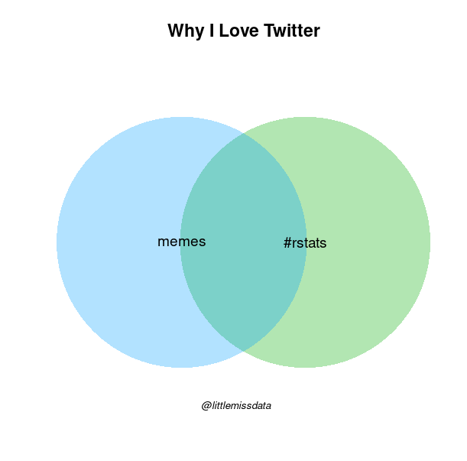
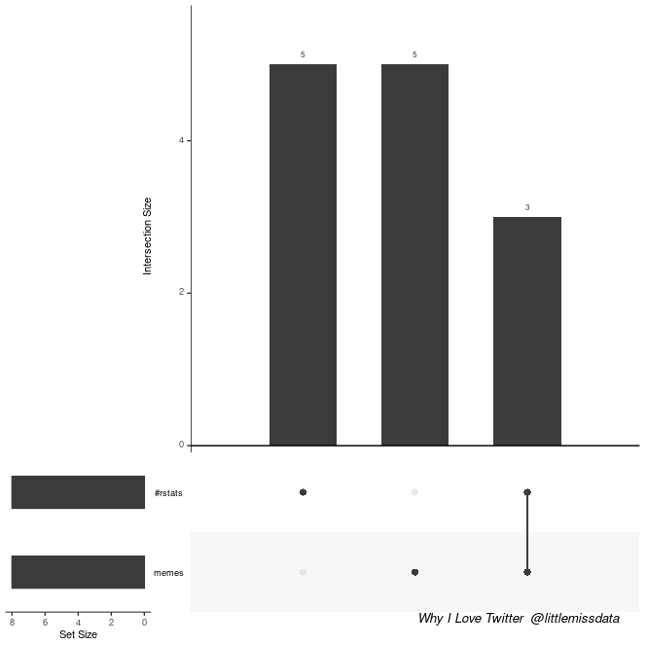
Tiny and Fun Set Intersections

Slide 18
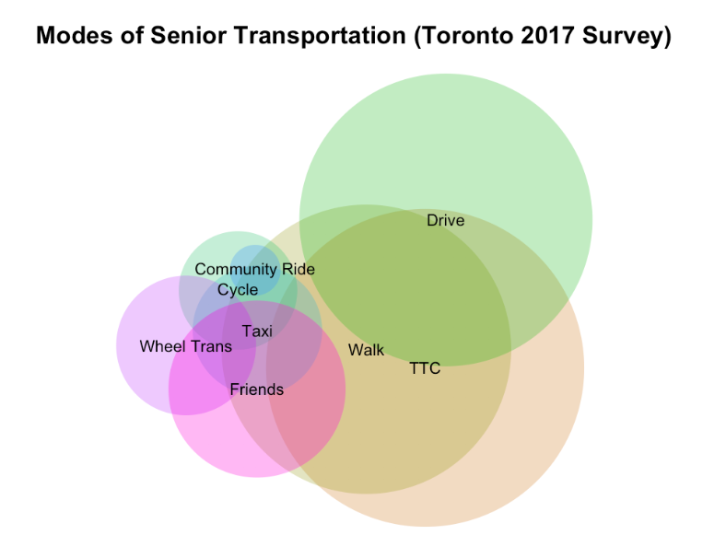
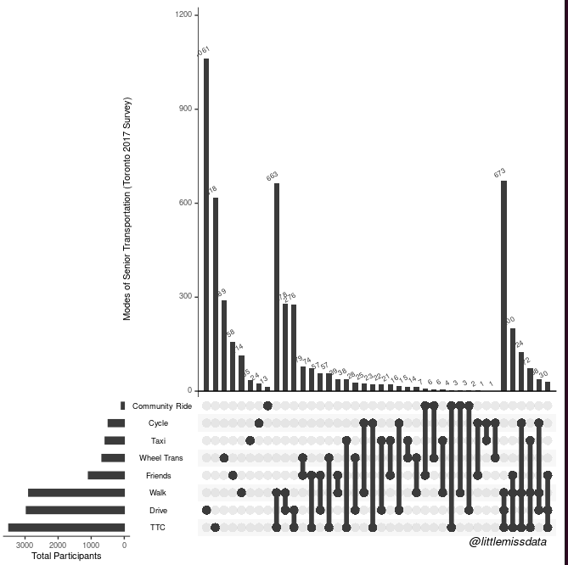
Complicated Sets

Slide 19
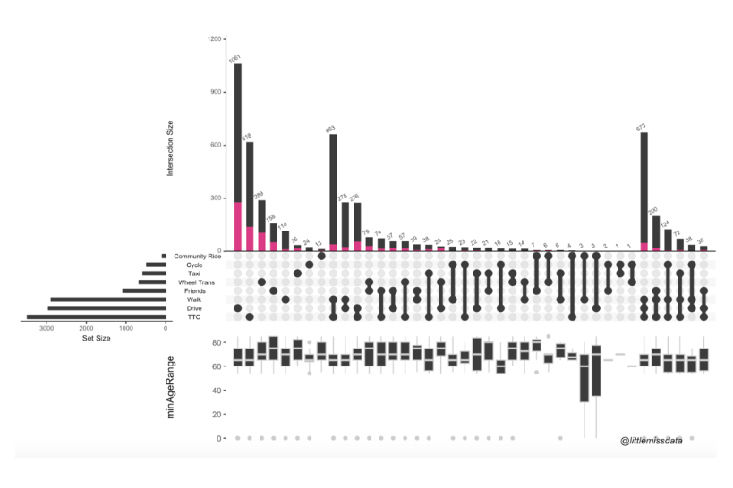
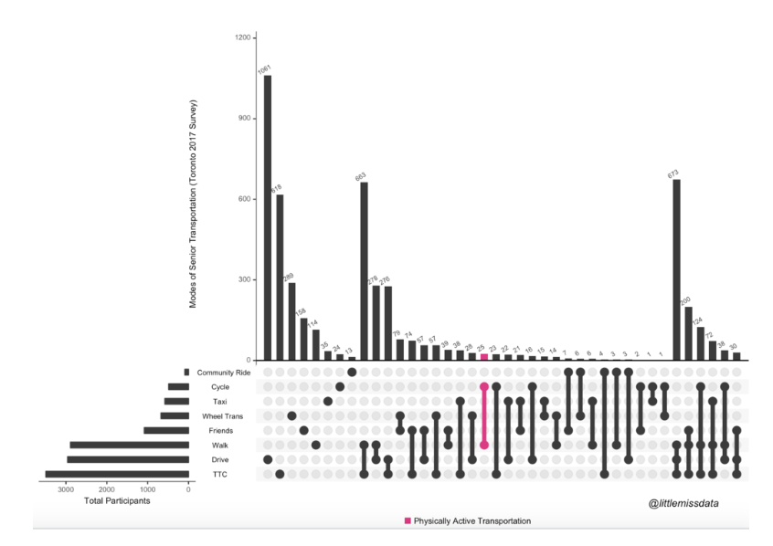
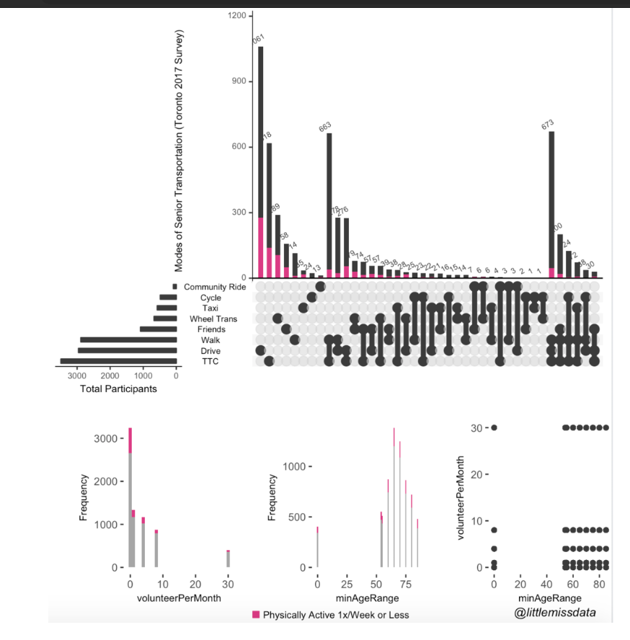
Explore In Context Set Information
https://www.littlemissdata.com/blog/set-analysis

Slide 20
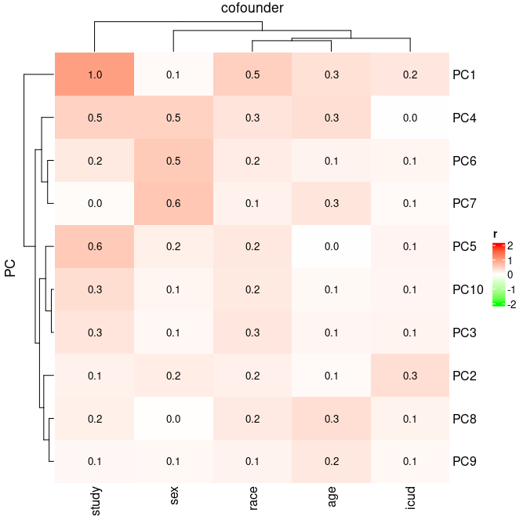
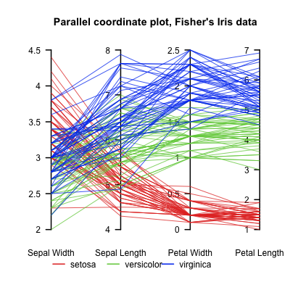
Heatmap vs Parallel coordinates

Slide 21
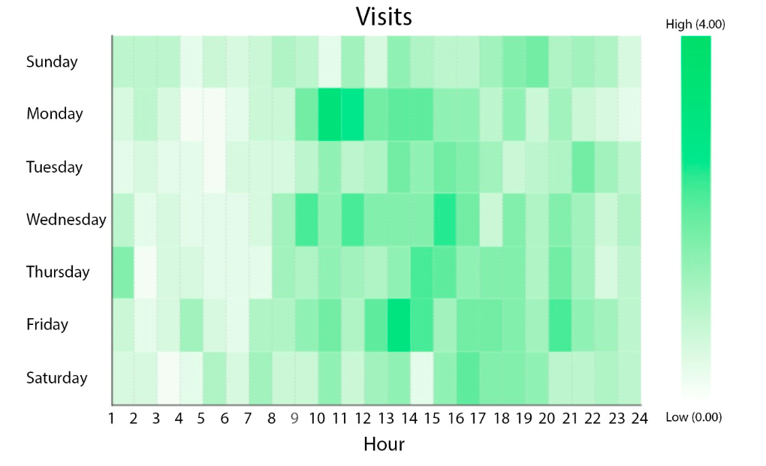
Heatmap
Heat Maps are graphical representations of data that utilize color-coded systems. The primary purpose of Heat Maps is to better visualize the volume of locations/events within a dataset and assist in directing viewers towards areas on data visualizations that matter most.
With large volumes of data, as colors are easier to distinguish and make sense of than raw numbers.
Extremely versatile and efficient in drawing attention to trends
This Heat Map is displaying the dates and times whereby the store is most heavily trafficked

Slide 22
Heat Map Adaptations
Business Analytics
Website
Exploratory Data Analysis
Marketing and Sales
Geovisualizatio
Molecular Biology: Heatmaps are used to study disparity and similarity patterns in DNA, RNA, etc.
https://towardsdatascience.com/all-about-heatmaps-bb7d97f099d7

Slide 23
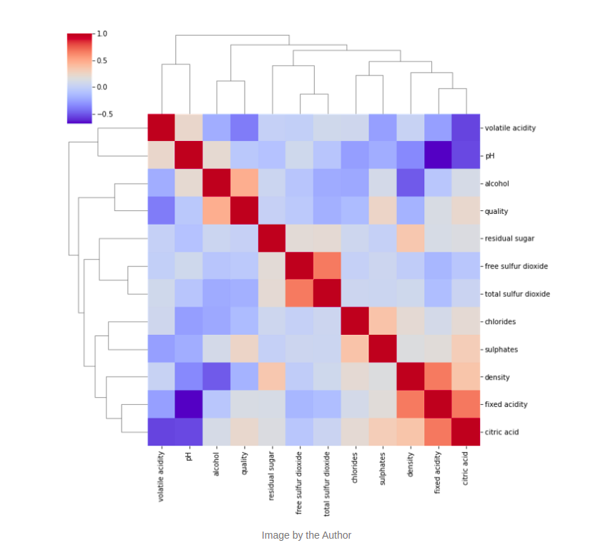
Tpye of HeatMaps
Clustered Heatmap
Clustered Heatmap: The goal of Clustered Heatmap is to build associations between both the data points and their features. This type of heatmap implements clustering as part of the process of grouping similar features. Clustered Heatmaps are widely used in biological sciences for studying gene similarities across individuals.

Slide 24
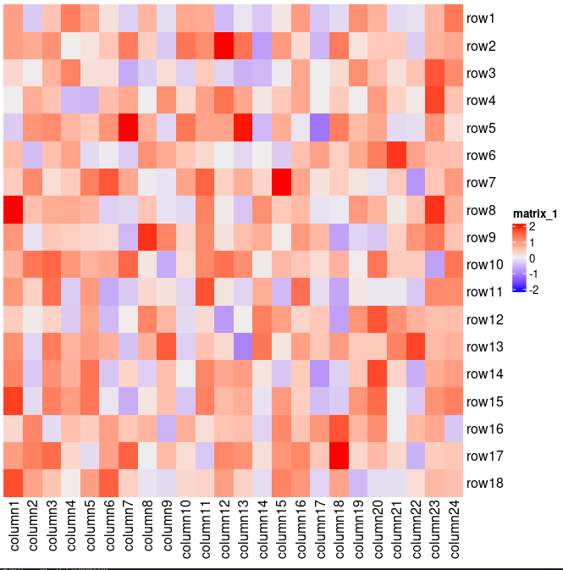
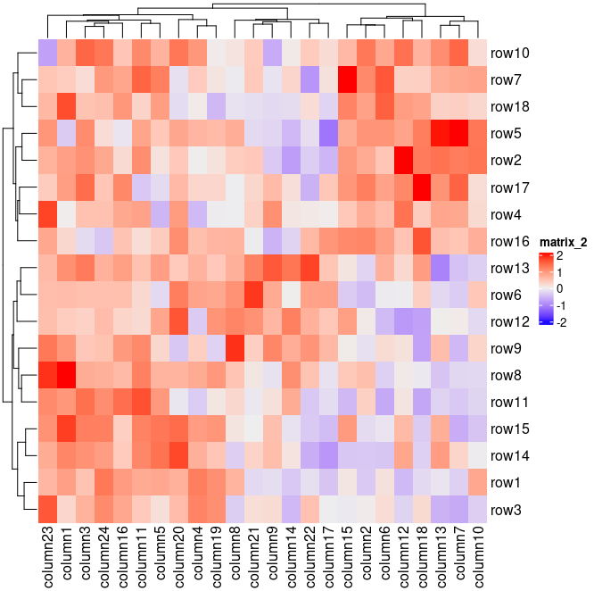
Using cluster analysis to improve the heatmap
Clustering might be the key component of heatmap visualization.
Heatmap(mat, cluster_columns = FALSE, cluster_rows = FALSE)
Heatmap(mat, cluster_columns = TRUE, cluster_rows = TRUE)
https://jokergoo.github.io/ComplexHeatmap-reference/book/index.html

Slide 25
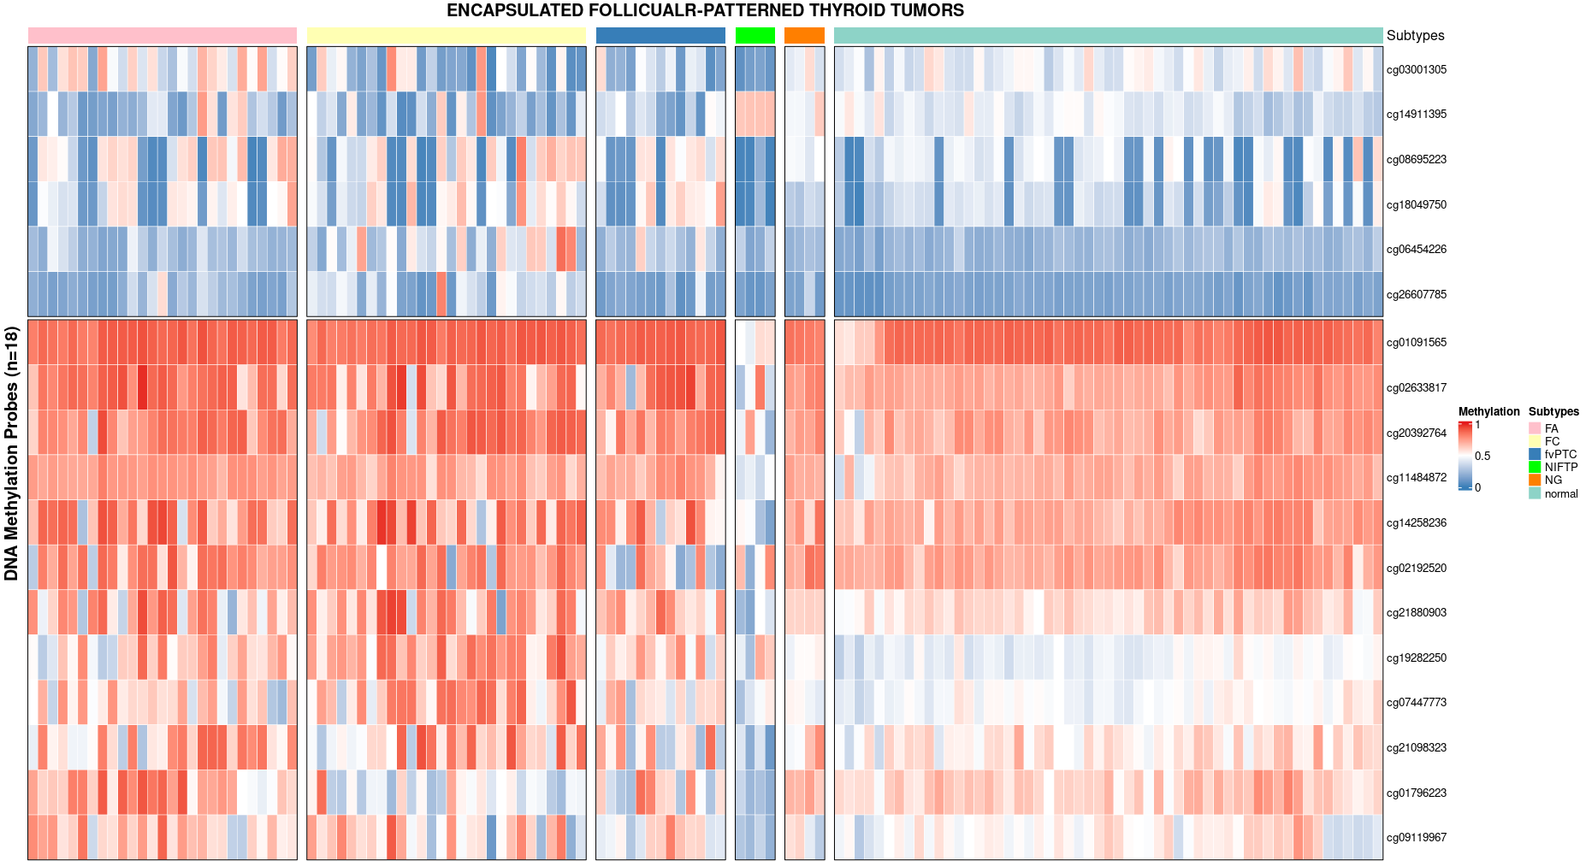
Using cluster analysis to improve the heatmap

Slide 26
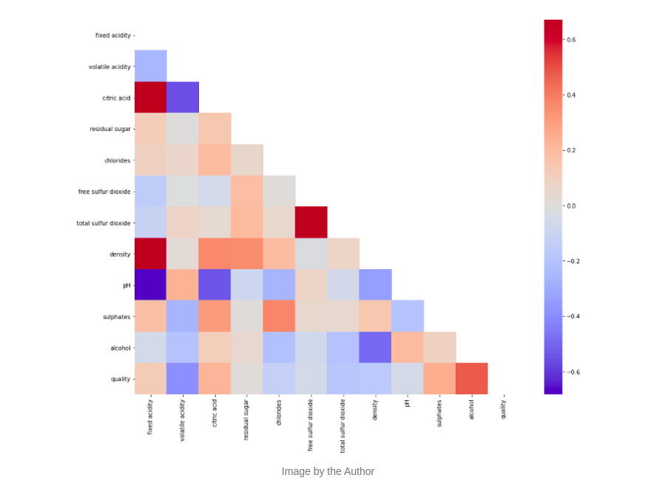
Tpye of HeatMaps
Correlogram
Correlogram: A correlogram replaces each of the variables on the two axes with numeric variables in the dataset. Each square depicts the relationship between the two intersecting variables, which helps to build descriptive or predictive statistical models.
https://towardsdatascience.com/all-about-heatmaps-bb7d97f099d7

Slide 27
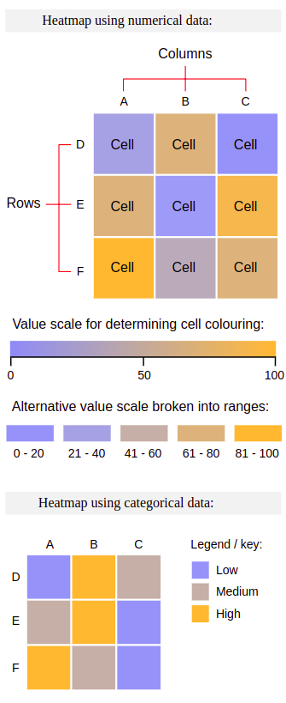
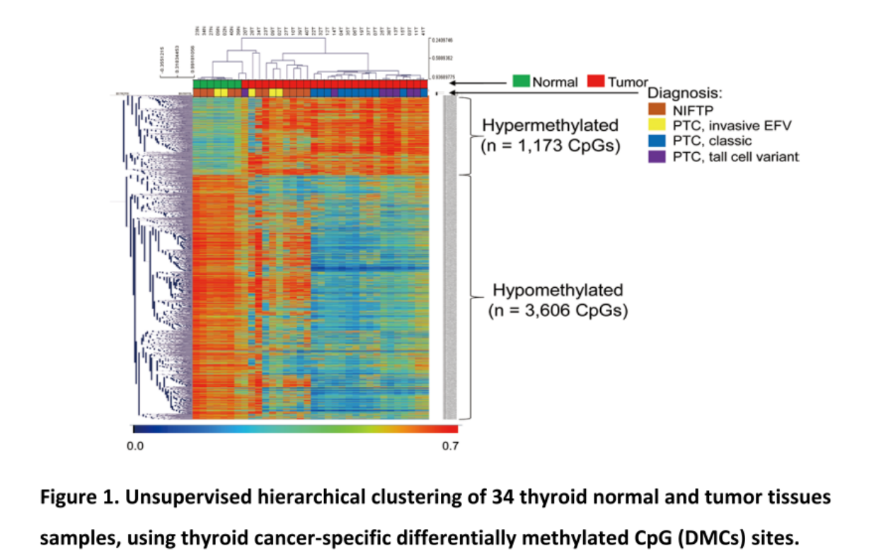
Structure of Heatmap
https://pubmed.ncbi.nlm.nih.gov/31797753/#:~:text=for%20Thyroid%20Cancer-,Comprehensive%20DNA%20Methylation%20Profiling%20Identifies%20Novel%20Diagnostic%20Biomarkers%20for%20Thyroid,doi%3A%2010.1089%2Fthy.
https://datavizcatalogue.com/methods/heatmap.html

Slide 28
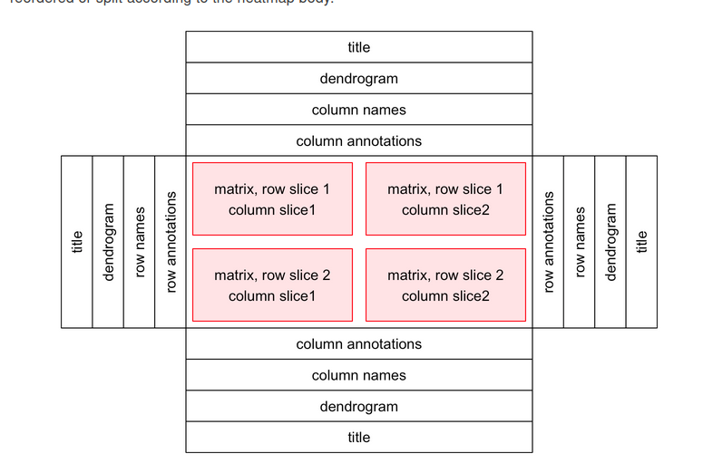
Howto creat a Heatmap in R
A single heatmap is composed of the heatmap body and the heatmap components
library(ComplexHeatmap)
library(circlize)
Notes:
The heatmap body can be split by rows and columns. The heatmap components are titles, dendrograms, matrix names and heatmap annotations, which are put on the four sides of the heamap body.

Slide 29
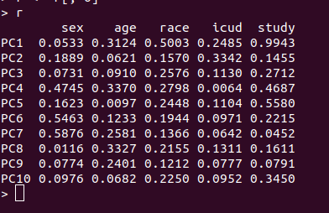
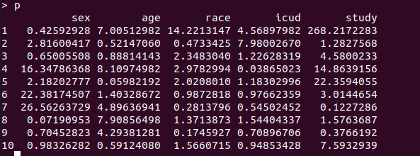
Data input
r <- read.table("/home/minhhoang/Documents/Data visalization/BT_ cofounder/r.tsv", header=T, sep="\t")
p <- read.table("/home/minhhoang/Documents/Data visalization/BT_ cofounder/p.tsv", header=T, sep="\t")
> dim(r)
[1] 10 5
> dim(p)
[1] 10 5

Slide 30
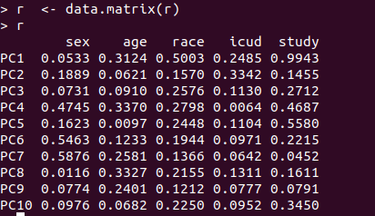
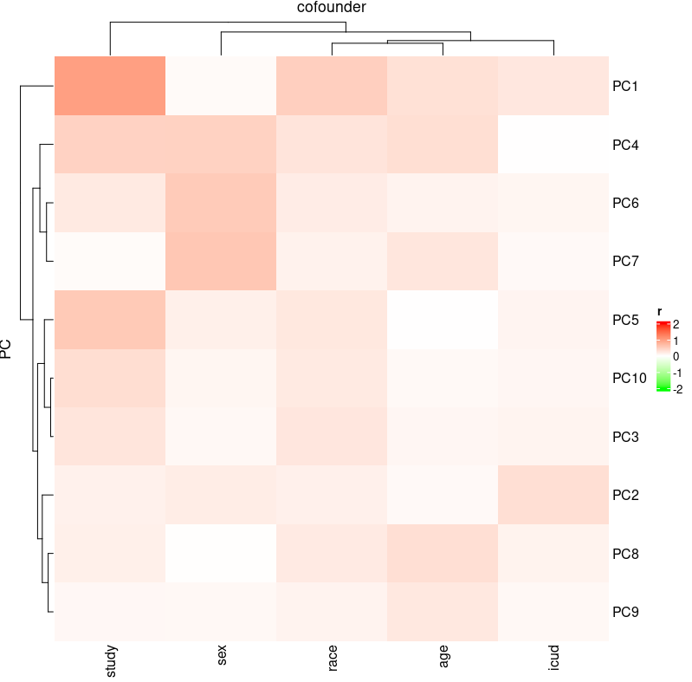
Simple Heatmap
Heatmap(r)
library(circlize)
library(ggplot2)
col_fun = colorRamp2(c(-2, 0, 2), c("green", "white", "red"))
col_fun(seq(-3, 3))
Heatmap(r, col = col_fun, name = "r", column_title =
"cofounder", row_title = "PC")

Slide 31
Number?

Slide 32
Heatmap(r, col = col_fun,name = "r", column_title = "cofounder",
row_title = "PC",
cell_fun = function(j, i, x, y, width, height, fill) {
if(r[i, j] > 0)
grid.text(sprintf("%.1f", r[i, j]), x, y, gp = gpar(fontsize = 10))
})

Slide 33
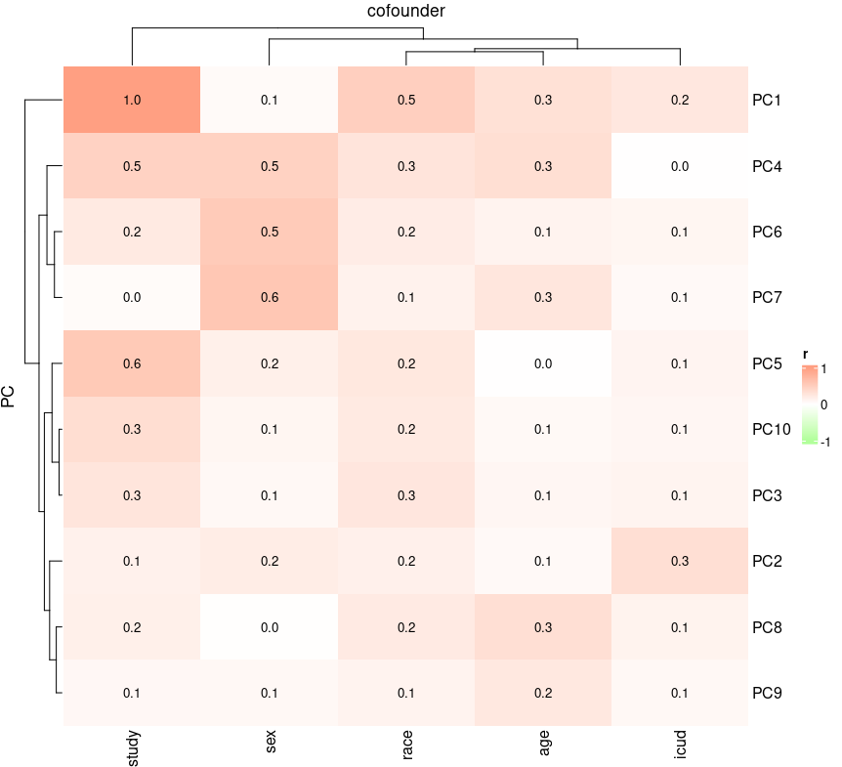
Heatmap(r, col = col_fun, column_title = "cofounder", heatmap_legend_param = list(at = c(-1, 0, 1), title = "r"),
row_title = "PC",
cell_fun = function(j, i, x, y, width, height, fill) {
if(r[i, j] > 0)
grid.text(sprintf("%.1f", r[i, j]), x, y, gp = gpar(fontsize = 10))
})

Slide 34
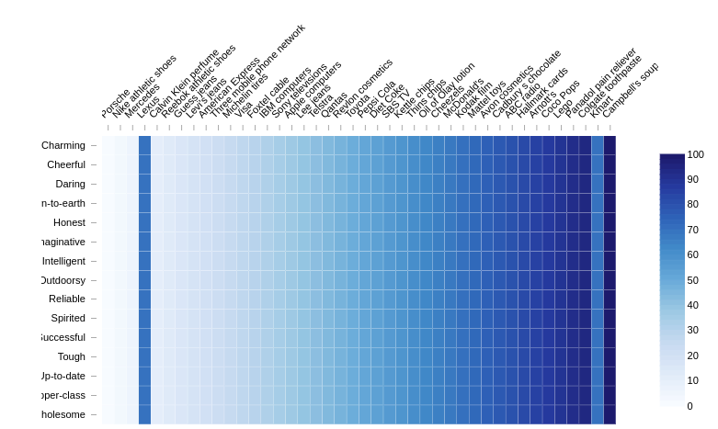
Advantage and disadvantage
https://www.displayr.com/the-problem-with-heatmaps/
Notes:
In the heatmap below I have used some made up data to illustrate this problem. Lexus, fourth from the left, has the same color as Kmart, which is second from the right. However, even though I have told you that these two colors are the same, your brain tells you something different. Your brain tells you that the Lexus color is darker than the Kmart color. Even if you hover your mouse over each, confirming that they are both 70, your brain still can't break the illusion.

Slide 35
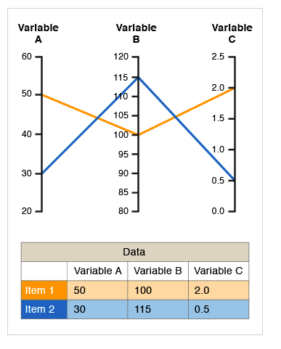

Parallel coordinates
This type of visualisation is used for plotting multivariate, numerical data. Parallel Coordinates Plots are ideal for comparing many variables together and seeing the relationships between them.
Parallel coordinates are a common way of visualizing and analyzing high-dimensional datasets.
Notes:
In a Parallel Coordinates Plot, each variable is given its own axis and all the axes are placed in parallel to each other.
Each axis can have a different scale, as each variable works off a different unit of measurement, or all the axes can be normalised to keep all the scales uniform. Values are plotted as a series of lines that connected across all the axes. This means that each line is a collection of points placed on each axis, that have all been connected together.

Slide 36


Parallel coordinates
A parallel plot allows to study the features of samples for several quantitative variables. Its strength is that the variables can even be completely different: different ranges and even different units.

Slide 37

Parallel coordinates
Axis order
https://www.data-to-viz.com/graph/parallel.html
Notes:
The order the axes are arranged in can impact the way how the reader understands the data. One reason for this is that the relationships between adjacent variables are easier to perceive, then for non-adjacent variables. So re-ordering the axes can help in discovering patterns or correlations across variables.

Slide 38

Parallel coordinates
Highlighting
Notes:
Highlighting - a parallel plot being a line plot, the main caveat is the spaghetti chart where too many lines overlap, making the chart unreadable. Several workaround exist as described in this page. A solution is to highlight a specific sample or a specific group of interest:

Slide 39
Advantage and disadvantage
The main advantage offered by parallel coordinate is the representation of high dimensional data as a 2-dimensional visualization. As data is represented in the form of a line, it becomes easy to perceive the trend shown by data entries from the visualization. The axes order can be changed to check out the trend between two different axes.
The only disadvantage seen is the overlaying of data lines for common data values among data entries. However, this issue can be addressed to a certain degree by changing the axes order in the visualization.

Slide 40

Alluvial plots
Admit Gender Dept Freq
1 Admitted Male A 512
2 Rejected Male A 313
3 Admitted Female A 89
4 Rejected Female A 19
5 Admitted Male B 353
6 Rejected Male B 207
7 Admitted Female B 17
8 Rejected Female B 8
9 Admitted Male C 120
10 Rejected Male C 205
11 Admitted Female C 202
12 Rejected Female C 391
https://cran.r-project.org/web/packages/ggalluvial/vignettes/ggalluvial.html
Notes:
UCBAdmissions

Slide 41

Forest Plots
The most common way to visualize meta-analyses is through forest plots. Such plots provide a graphical display of the observed effect, confidence interval, and usually also the weight of each study. They also display the pooled effect we have calculated in a meta-analysis. Overall, this allows others to quickly examine the precision and spread of the included studies, and how the pooled effect relates to the observed effect sizes.
Forest plot displaying univariate Cox analysis of BARD1 expression.
https://www.ncbi.nlm.nih.gov/pmc/articles/PMC6900616/
Notes:
Meta-analysis is a research process used to systematically synthesise or merge the findings of single, independent studies, using statistical methods to calculate an overall or ‘absolute’ effect.2 Meta-analysis does not simply pool data from smaller studies to achieve a larger sample size.

Slide 42

How to read a forest plot
The forest plot is a key way researchers can summarise data from multiple papers in a single image.
Notes:
What a forest plot does, is take all the relevant studies asking the same question, identifies a common statistic in said papers and displays them on a single set of axis. Doing this allows you to compare directly what the studies show and the quality of that result all in one place.

Slide 43



How to read a forest plot
https://s4be.cochrane.org/blog/2016/07/11/tutorial-read-forest plot/?fbclid=IwAR2E9XUnU72DSaGKwdk8lHUaJgx6MT5Rf3LH8PcT5dhp7Dj4j2dGGIFBJLM
Notes:
OR or RR have a null effect value of 1. For absolute statistics like Absolute Risk or ARR or SMD, the null difference value is 0
the diamond is probably the most important thing you will see on a forest plot.

Slide 44

How to read a forest plot

Slide 45

Heterogeneity of the papers

Slide 46


https://www.youtube.com/watch?v=Pxs0gl3hRKE
Notes:
Giải thích các thông số

Slide 47



How to draw forest plot in R?
https://www.youtube.com/watch?v=GRtLOf_izfI&t=318s

Slide 48
Summary about forest plot.
Each horizontal line on a forest plot represents an individual study with the result plotted as a box and the 95% confidence interval of the result displayed as the line.
The implication of each study falling on one side of the vertical line or the other depends on the statistic being used.
If the individual study crosses the vertical line, it means the null value lies within the 95% confidence interval. This implies the study result is in fact the null value and therefore the study did not observe a statistically significant difference between the treatment and control groups.
The diamond at the bottom of the forest plot shows the result when all the individual studies are combined together and averaged. The horizontal points of the diamond are the limits of the 95% confidence intervals and are subject to the same interpretation as any of the other individual studies on the plot.
The I2 statistic gives you an idea of the heterogeneity of the studies, i.e. how consistent they are. If the I2 value is >50% it might mean the studies are inconsistent due to a reason other than chance. This might make the conclusions you draw from the forest plot questionable.

Slide 49

Scatter Plot Matrices
A scatter plot matrix is a grid of several scatter plots of up to five numeric variables. The matrix includes individual scatter plots for every combination of variables.
A scatter plot matrix can answer questions about your data, such as:
1. Are there any pair-wise relationships between different variables? And if there are relationships, what is the nature of these relationships?
2. Are there any outliers in the dataset?
3. Is there any clustering by groups present in the dataset on the basis of a particular variable?

Slide 50



Slide 51


Correlation panel

Slide 52

Use the R package psych

Slide 53

Execrise
library(gcookbook)
head(countries)
Please tell us the correlation between Name, GDP, laborrate, healthexp, infmortality through Scatter Plot Matrices and explain the result?

Slide 54


Slide 55


Slide 56


